Slide 1
Lists

Slide 2

Objectives
At the end of this lecture, you will learn how to:
Create Lists
Process Lists using List operators and methods
Notes:
In this lesson, you will learn the concepts of a list in Python, including creating a list, retrieving individual elements in the list, and performing a number of operations on any list.

Slide 3
What is List
A list is considered a sequence type in Python, similar to Strings.
A list is a sequence of values.
In a string, the values are characters.
In a list, the values can be any type.
Values in a list are called elements or items.
string friend
P
e
t
e
r
Position
0
1
2
3
4
list friends
Peter
John
Mary
David
Index
0
1
2
3
Notes:
In the previous lesson, you saw that a String is a sequence of single characters like the letters of the alphabet, digits, and punctuation marks. For instance, a string consists of individual characters like P, E, T, E, and R,. Each index of the string refers to one character at the index position. On the other hand, a list is a sequence of values of any type.
The list shown in the slide is a list of Strings representing the names of people. Since a list is a sequence, the values of the list can be retrieved using indexes too. Just like String, the index starts from zero and increases accordingly. We sometimes call the values of a list, its elements, or, items.
So, in summary, every index of a String refers to a single character, while every index of a list refers to an element. Do you see that in the slide, each element of the list called friends, is a String representing their names?

Slide 4
Examples of List
Names of your friends
List of students' marks
Shopping list
Recipe – a list of instructions
Text document – a list of lines
Peter
84.7
David
71
Vincent
55
Hafiz
80
Janet
63
Albert
….
….
S9099885K;Ang PS;98765432
S9177885P;David Davis;89778899
S9267890A;Lim Vincent;91990099
S9111199Q;Tan SS;88995566
….
Notes:
Here are more examples of what a list can store. Again, a String stores individual characters, while a list can store Strings and numbers. Since we can store Strings and numbers in a list, we can also store sentences in a list as well.

Slide 5
Creating a List
Enclose the elements in square brackets, separate each element by commas.
E.g. [ ]
[ 'Peter', 'John', 'Mary', 'David' ]
[ 89, 77, 55, 69 ]
Usually we assign the list to a variable name so that we can refer to the list subsequently:
E.g. emptyList = [ ]
friendsList = [ 'Peter', 'John', 'Mary', 'David' ]
marksList = [ 89, 77, 55, 69 ]
Notes:
A list is defined by enclosing its elements in a pair of square brackets, separated by commas. The first example showing just the pair of square brackets represents an empty list, to which you can add new elements in your Python code. If you want to quickly delete all the elements of a list, assign the empty list to the variable. The next example shows a list containing Strings as its elements. Each String is enclosed by a pair of single quotation marks. These Strings are also separated by commas. The last list is just a list of numbers. Whether the list is empty or not, a list is always enclosed by a pair of square brackets.
If you want to use a list in Python, you need to assign a list to a variable name. By now, you should develop the habit to call your variables with meaningful names, as shown in the slide.

Slide 6
Creating a List
An element in a list can be another list – nested list.
E.g. friendsList = ['Peter', ['John', 'Mary'], 'David']
matrix = [ [1,2,3], [4,5,6], [7,8,9] ]
A list that contains no elements is called an empty list.
E.g. emptyList = [ ]
A list may contain elements of different types.
E.g. mixedList = ['Peter', 100, 23.5, [10, 20]]
Notes:
Since a list is a sequence of values of any type, its element can be another list too. Take a look at the first example list, called friends list. The first element is the string Peter. The second element is a list containing, John, and, Mary. This second list is an example of a nested list, where a list is contained inside another list. The next example of nested list, called matrix, contains 3 elements. Each of these elements is another list of 3 numbers. Do you see that this definition corresponds to a 3 by 3 matrix?
So far, you have seen lists containing Strings only, or numbers only. In fact, a list can store elements of different types together. The last example list, called mixed list, contains a String, 2 numbers, and a nested list. As an illustration, you can use a list to store a person’s individual details like, name, address, date of birth, age, weight, and height.

Slide 7
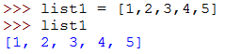
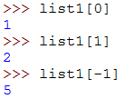
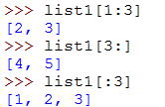
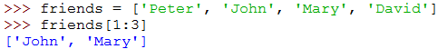
Basic Operators for List
Use the bracket operator [n] to access an element in the list.
Use the [n:m] operator to access part of the list from index n to m.
Usage is similar to Strings
Notes:
The bracket operator you used for Strings can be used in the same manner for list. This includes retrieving an element by using a single index, or a part of a list by using a pair of indexes, separated by the colon punctuation mark. I hope you remember that the index value of the first element is: zero. Study the examples in the slide carefully to make sure you understand.

Slide 8
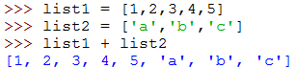
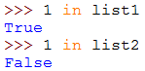
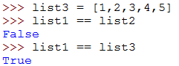
Basic Operators for List
+ operator concatenates lists.
in operator detects the presence of an element in the list.
== operator compares the equality of two lists
Notes:
Similarly, the operators used in Strings can also be used in lists, such as list concatenation, and the membership, in, operator. Again, study the examples carefully. The last operator, consisting of 2, equal signs, is to test if two lists are equal. Two lists are equal, if their elements are themselves equal, in values. Moreover, the values must be equal at the same corresponding position indexes. In other words, element at index zero, index one, index two and so on, of both lists must be equal. Since this operator tests for equality, it returns a true or false answer.

Slide 9
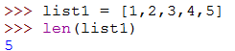
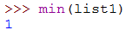
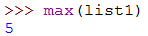
Basic Functions for List
function len() returns the number of elements in the list.
function min() returns the smallest element in the list.
function max() returns the largest element in the list.
Notes:
There are also built-in list functions to help you process a list. For example, the length function, L, E, N, tells you the number of elements there are in the list. Likewise, the min, and max functions tell you the smallest and largest, elements in the list. Pay attention to the examples to understand how these functions are used in Python.

Slide 10
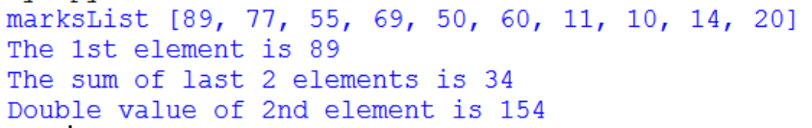
Activity 1 – ProcessMarks.py
Create a list called marksList that contains 10 elements.
Display the value in the first element of marksList.
Add the values in the last two elements of marksList and assign the result to the variable sum.
Double the value in the second element of marksList.
Sample output

Slide 11
Built-in List methods
Methods | Description | Example letters=['a','b']
append(x) | Add an element, x, to the end of the list. | letters.append('c') letters ['a', 'b', 'c']
extend(L) | Extend list by appending all the items in the given list L. | letters.extend(letters) letters ['a', 'b', 'c', 'a', 'b', 'c']
insert(i,x) | Insert an item, x, before the given position i in the list. | letters.insert(3,'z') letters ['a', 'b', 'c', 'z', 'a', 'b', 'c']
Notes:
The next two built-in functions behave almost similarly, but there are differences that you should take note of. The append function can add an element or a list to the end of another list. The example shown here adds an element to the end. You can append another list to the end too.
For the extend function, you can add another element to the end of the list. However, if you extend a list, with another list, then every element of the second list is added to the end of the first list.
The insert function allows you to insert an element at the specified index position in the list. Remember that index value starts from zero, so index position 3, is actually the fourth element.
list1 = [1,2,3]
list1.append('c')
list1 is now [1, 2, 3, 'c’]
list1.append( ['a','b’] )
list1 is now [1, 2, 3, 'c', ['a', 'b']]
list2 = [1,2,3]
list2.extend('c')
list2 becomes [1, 2, 3, 'c’]
list2.extend( ['a','b’] )
list2 becomes [1, 2, 3, 'c', 'a', 'b']

Slide 12
Built-in List methods
Methods | Description | Example letters is the list ['a', 'b', 'c', 'z', 'a', 'b', 'c']
remove(x) | Remove the first item from the list whose value is x. Error occurs if x is not in the list. | letters.remove('c') letters ['a', 'b', 'z', 'a', 'b', 'c'] letters.remove('d') ValueError: list.remove(x): x not in list
pop([i]) | Remove the item at the given position in the list and return it. Removes and returns the last item in the list if the argument is not stated. | letters.pop(2) ➔ 'z' letters ['a', 'b', 'a', 'b', 'c'] letters.pop() ➔ 'c' letters ['a', 'b', 'a', 'b']
Notes:
The next 2 built-in functions allow you to delete elements from a list, but with some differences. The remove function requires you to know the element that you want to delete. If the element is not present in the list, you will get an error message telling you so.
On the other hand, the pop function will remove an element, even though you do not know what that element is. You can pop an element at a given index position value, or pop the last element in the list. In both cases, the element that has been removed can be assigned to a variable so that you can examine it further, depending on the logic of you solution.

Slide 13
Built-in List methods
Methods | Description | Example Letters is the list ['a', 'b', 'a', 'b']
index(x) | Return the index in the list of the first item whose value is x. Error occurs if x is not in the list. | letters.index('a') ➔ 0 letters.index('c') ValueError: 'c' is not in list
count(x) | Return the number of times x appears in the list. | letters.count('a') ➔ 2
reverse() | Reverse the elements of the list in place. | letters.reverse() letters ['b', 'a', 'b', 'a']
sort() | Sort the items of the list in place. | letters.sort() letters ['a', 'a', 'b', 'b']
clear() | Remove all items from the list. | letters.clear()
Notes:
There are more built-in List functions that you will use quite often as you write more complex Python code. Study the examples shown, and let your tutor know if you require clarification.

Slide 14
Activity 2
Given that the list firstList and secondList are created as follows:
firstList = [ 2, 4, 6, 8, 10 ]
secondList = [ 2, 4, 6, 8, 10 ]
Evaluate the output in the following pages.

Slide 15
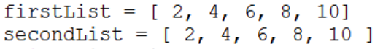
Evaluate
Program Text | Output
print(firstList[1]) | 4
print(firstList[-1]) | 10
print(firstList[5]) | error
print(firstList[1:3]) | [4,6]
print(firstList[:3]) | [2,4,6]
print(firstList[3:]) | [8,10]
print(firstList) | [ 2, 4, 6, 8, 10]

Slide 16
Evaluate
Program Text | Output
print(len(firstList)) | 5
print(secondList) | [ 2, 4, 6, 8, 10]
print(firstList == secondList) | True
thirdList = firstList + secondList print(thirdList) | [ 2, 4, 6, 8, 10, 2, 4, 6, 8, 10]
print(5 in firstList) print(5 not in secondList) | False True

Slide 17
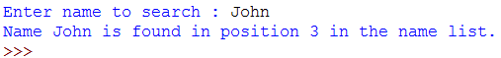
Activity 3 – SearchName.py
Write a Python program to
Declare a list of strings nameList and initialize with the following string elements "Tom", "Joe", "Mary", "John", "Bob", "Jane"
Prompt user to input the name to search and check if the name exists in the list nameList
Display the index of the name list

Slide 18
Reading Reference
How to Think Like a Computer Scientist: Learning with Python 3
Chapter 11
http://openbookproject.net/thinkcs/python/english3e/index.html

Slide 19
Summary
Creating Lists
List operators and methods

